Slide 1


North Western University
Course Tittle: Software Development Sessional III
Course Code: CSE – 3204
August 23,2022
LIBRARY MANAGEMENT SYSTEM

Slide 2


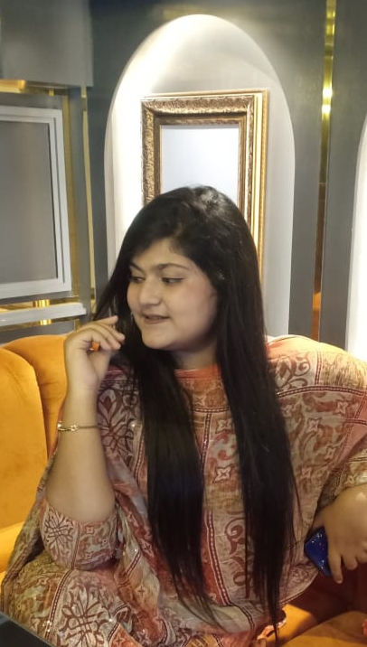
Team Name
NWU_LMS
Details of the Team Members
Parag Biswas
ID: 20201138010
Department of CSE
North Western University
Swan Mollick
ID:20201147010
Department of CSE
North Western University
Afra Anika Urbee
ID:20201159010
Department of CSE
North Western University

Slide 3
Over View:
Introduction
Objective
Site Tree
E-R Diagram
Description
Liberian
Admin
Dependencies
Conclusion

Slide 4
Introduction: . Library Management is a software use to manages the catalog of a library . This helps to keep the records of whole transactions of the books available in the library. . A library is a collection of sources, resources, and services, and the structure in which it is housed; it is organized for use and maintained by a public body, an institution, or a private individual.

Slide 5
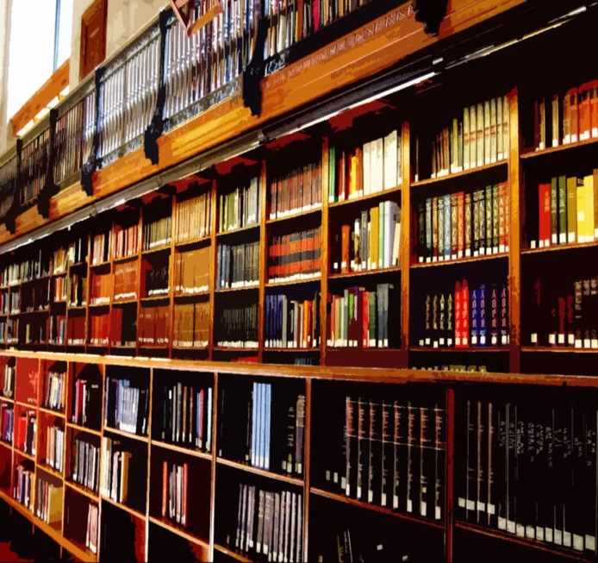
Objectives: The Project objectives are- ➢To eliminate the paper work in the library. ➢ Simplify search/discovery of library resources. ➢ Simplify payment system. ➢ Build and manage library collections in support of academic programs. ➢ Managing library facilities simply.

Slide 6
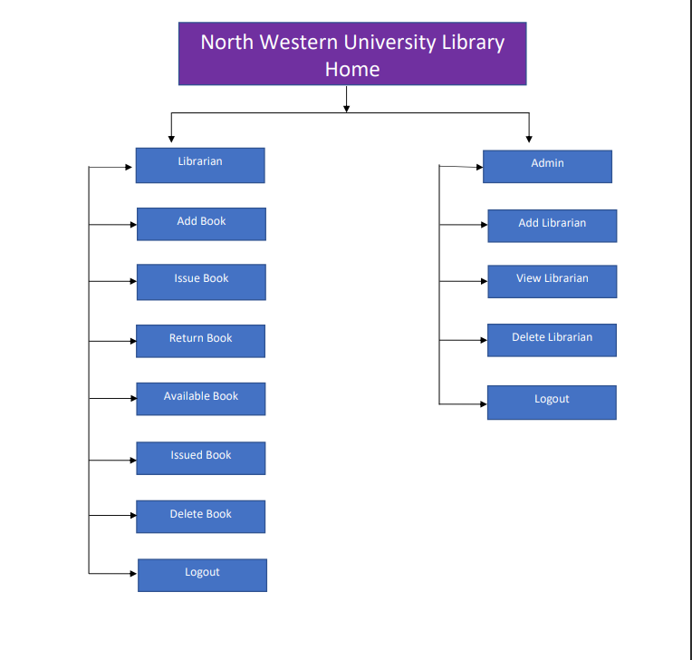
Site tree:
In the North Western Library, there are two Characters. Admin and Librarian. Each has a unique view and their own functionalities. A simple tree can show what these characters can view.
06

Slide 7
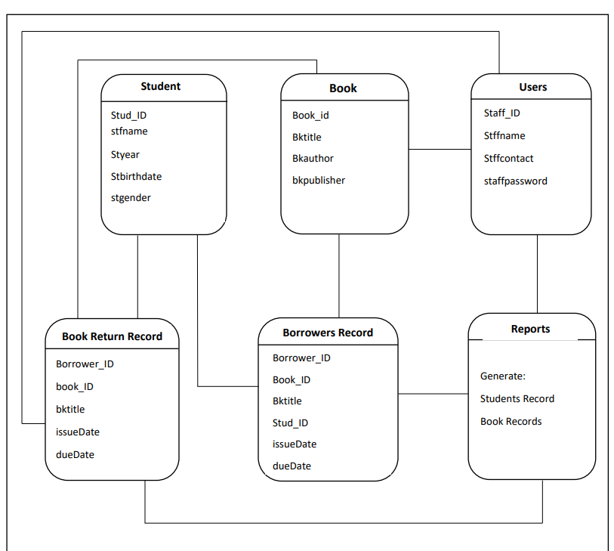
Entity Relationship Diagram:
07

Slide 8
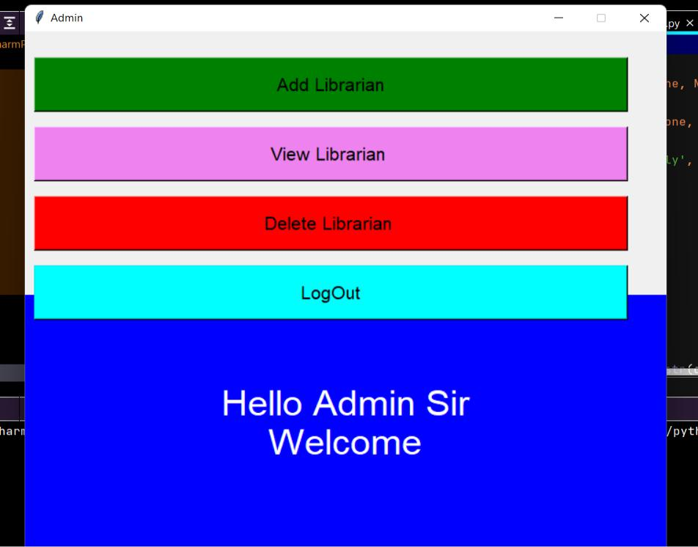
Description: Admin Panel: After login, the admin can view the admin control page of the North Western University Khulna Automation system as follow:
In this page, an admin can view and add the library to the system. He appoints a librarian and also delete to manage it properly.
After clicking Add Librarian the admin can added many librarians for manage his/her University Library.
08

Slide 9
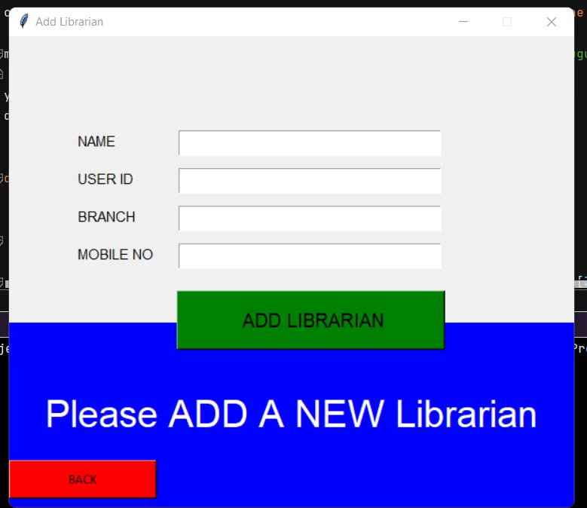
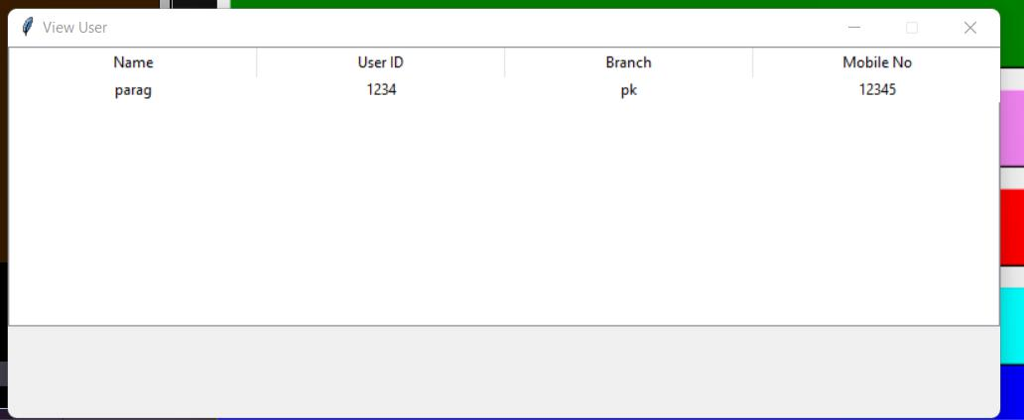
After clicking View Librarian the admin can view his/her added librarians for his/her University Library.
09

Slide 10
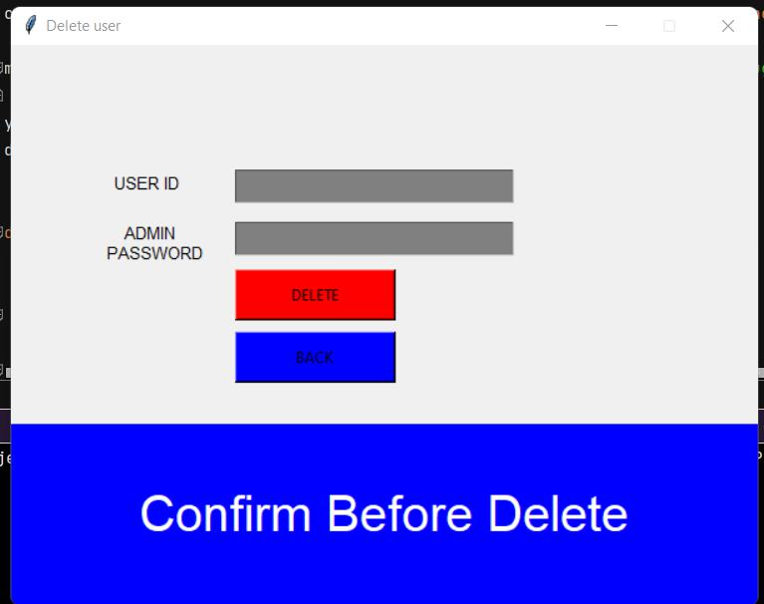
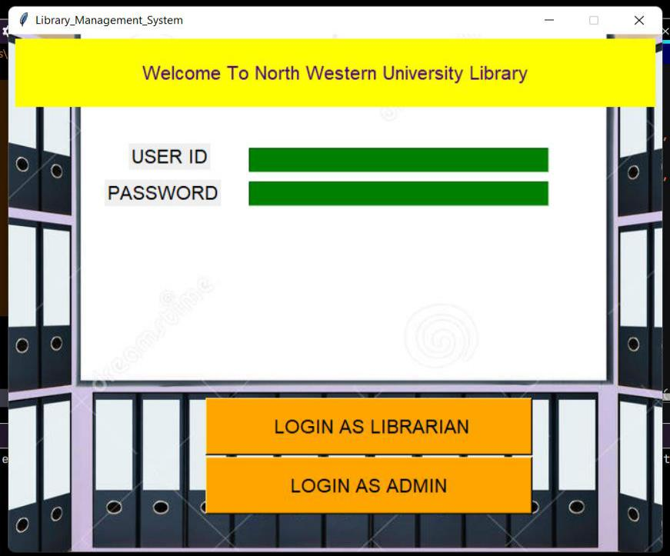
After clicking Delete Librarian the admin can Delete his/her added librarians for his/her University Library Database. The admin can delete the Librarian by his/her user id and admin password.
After clicking Last Bottom LOG OUT the admin can back to the Homepage of University Library.
10

Slide 11
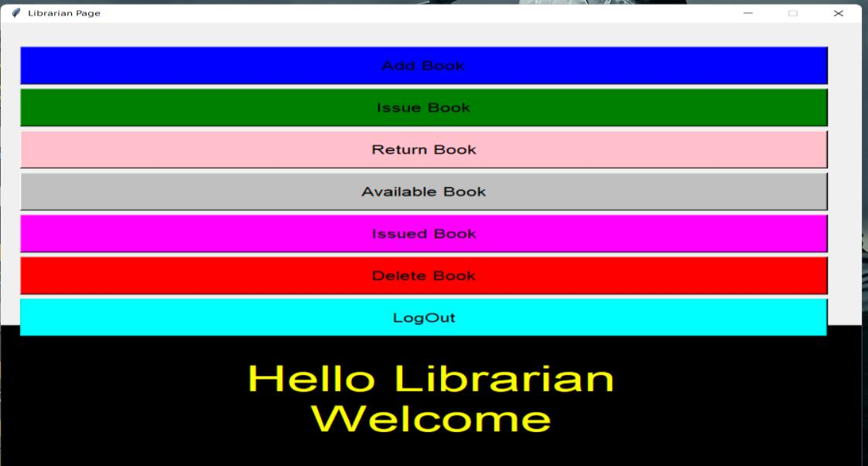
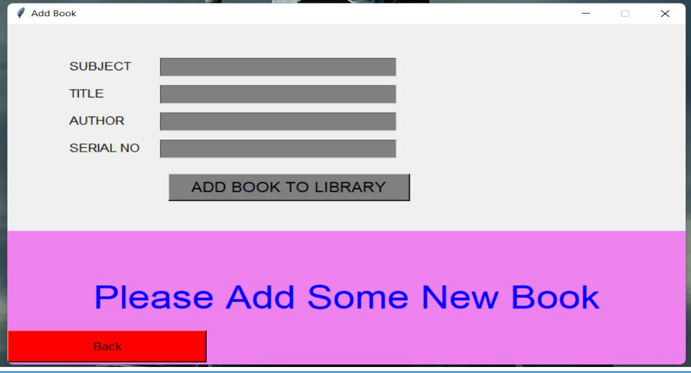
Librarian panel:
After login as the librarian, the librarian can view the homepage of the North Western University Khulna Automation system as follow:
After clicking Add Book the Librarian can added many books by its Subject, Title, Author name, Serial number of book, for his/her University Library Database.
11

Slide 12
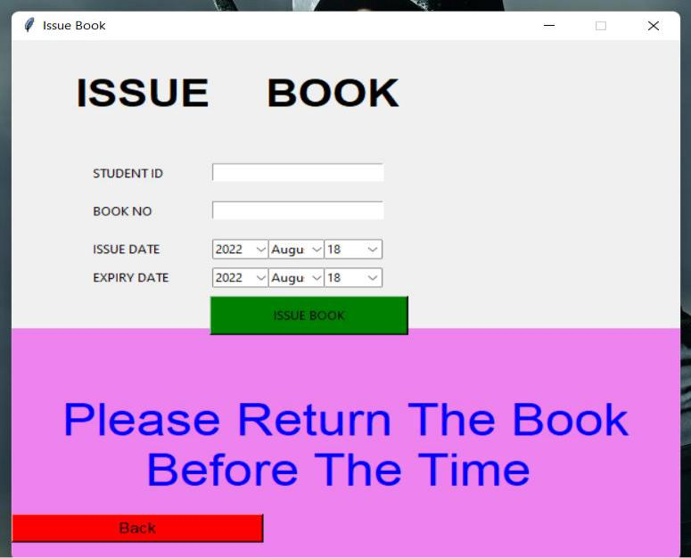
After clicking Issue Book the Librarian can Issue many books for a student by his/her Student ID and expire or issue date after added University Library Database.
12

Slide 13
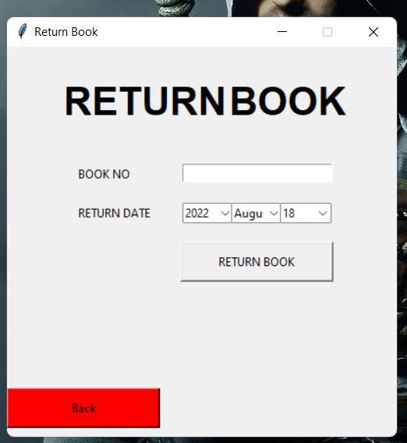
After clicking Return Book the Librarian view the page as follows:
13

Slide 14
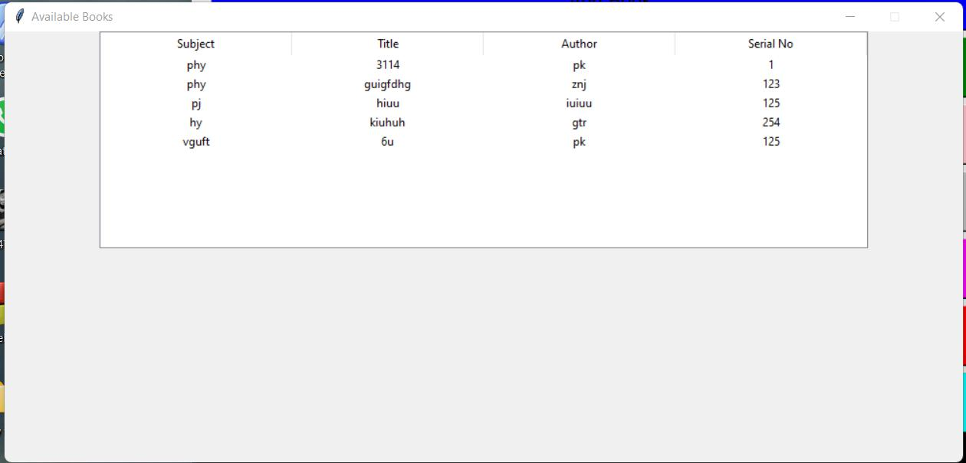
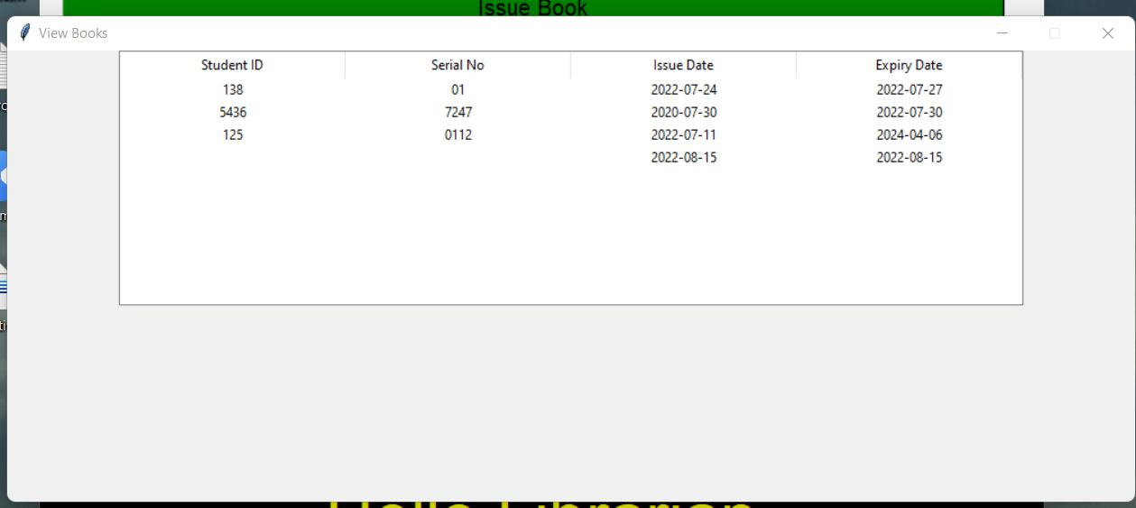
After clicking Available Book the Librarian can see how many books are added and what types of books are added in University Library Database.
After clicking Issued Book the Librarian can see which books are issued and who can issue this book and its issue date or expiry date.
14

Slide 15
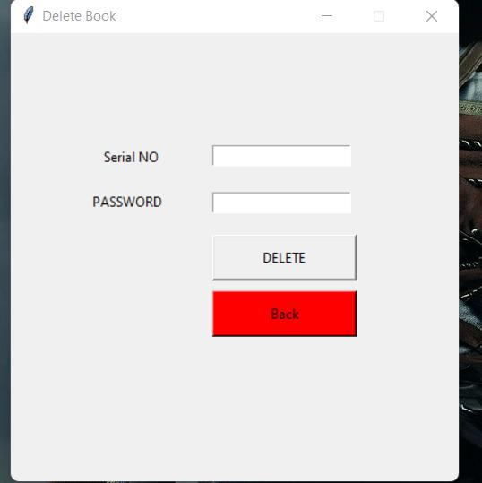
After clicking Delete Book the librarian can Delete Books by its serial and password and which are not available in the University library database.
15

Slide 16

After clicking Last Bottom LOG OUT the Librarian can back to the Homepage of University Library.
16

Slide 17
Dependencies:
PyCharm: The Library Management System (LMS) is built on PyCharm framework. So PyCharm framework is needed to run this system properly.
Python 3.9: PyCharm’s built in “Python 3.9” is needed to run LMS properly. Also, notification class and other configurations is need to set the notification of various actions.
Need to install many PyCharm packages to run this project properly.
17

Slide 18
Conclusion:
The project Library Management System is for computerizing the working in the Library.
The software takes care of all the requirements of an a library and is capable to provide easy and effective storage of information related to books & users.

Slide 19

Thank You

